Slide 1

Build a website with Hugo

Slide 2

What is Hugo?
Hugo is an open-source static site generator that’s written in Go
A static site generator is a tool that produces static HTML files from source files, typically written in more abstract formats like Markdown
These static HTML files can be hosted on any server without the need for server-side processing

Slide 3

Install Hugo
macOS
brew install hugo
Windows
winget install Hugo.Hugo.Extended
Linux
sudo snap install hugo
Docker
docker pull klakegg/hugo

Slide 4
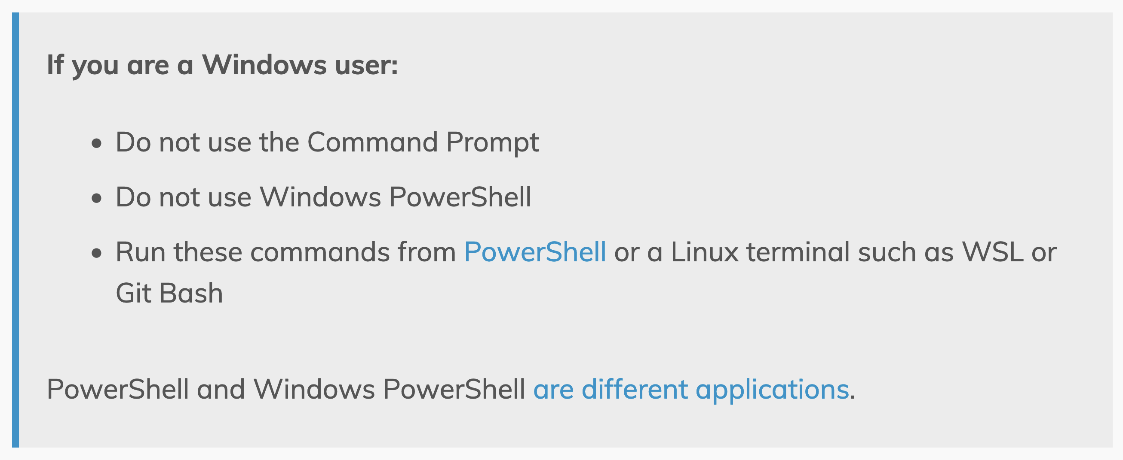
Do not use Windows PowerShell
Source: https://gohugo.io/getting-started/quick-start/#commands

Slide 5

Create a Hugo site
Create a new Hugo site
hugo new site <site name>
Change into the site directory
Set-Location –Path <site name>
Initialize the site as a Git repo
git init

Slide 6

Hugo Themes
Add
Add a theme
git submodule add <url to theme repo> themes/<theme name>
Configure
Configure Hugo to use the theme
Add-Content -Path hugo.toml -Value "theme = ‘<theme name>'"
Build
Build the site locally
hugo server

Slide 7
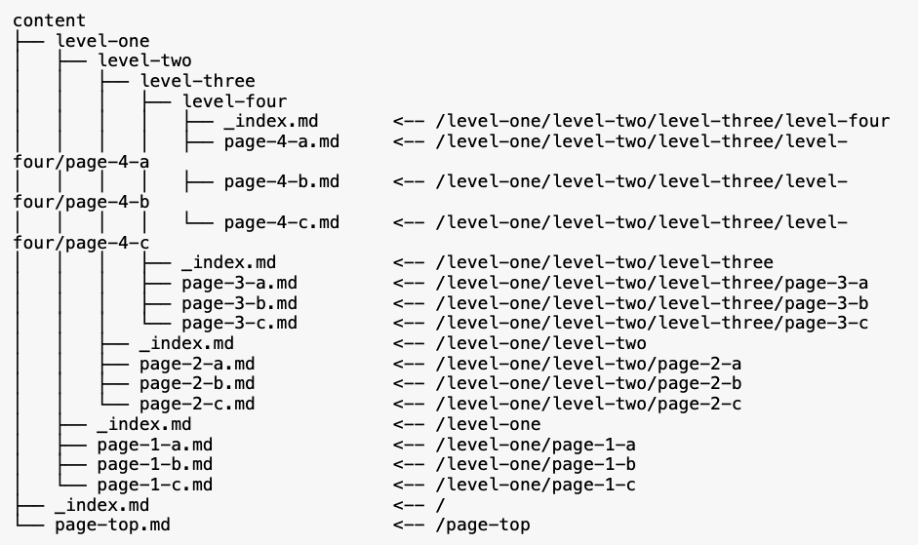
Adding content to Hugo
Content organization

Slide 8

Page bundles
Leaf bundles
A leaf bundle is a directory at any hierarchy within the content directory, that contains an index.md file
Branch bundles
A branch bundle is any directory at any hierarchy within the content directory, that contains at least an _index.md file

Slide 9

Publish to GitHub pages
Configure a GitHub action
Automatically build the website when the main branch is updated
Test the website
Deploy your content (docs)

